Slide 1



UNIT 3; People and places
An adventure

Slide 2

When was the last time you were in a museum? What kind of a museum was it? What did you see there? What kinds of museums are there? What would you like to see in a museum? Have you ever seen a film about a museum?

Slide 3
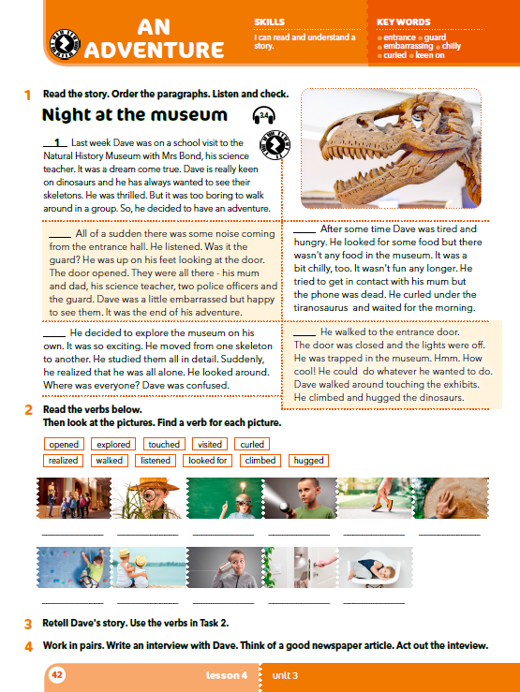
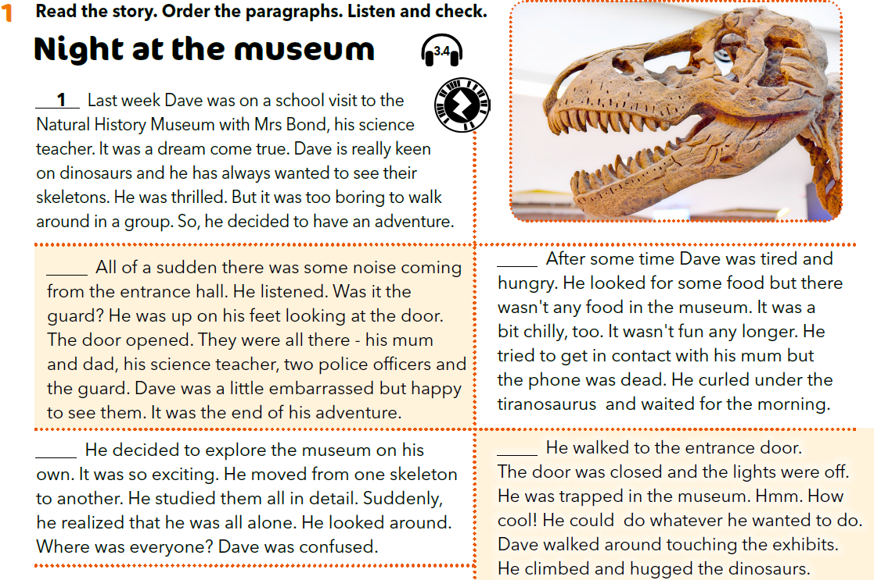

Read the story and order the paragraphs. Listen and check. https://www.e-sfera.hr/dodatni-digitalni-sadrzaji/1570e502-3238-4234-8542-c9d952e3ca00/assets/audio/13__unit_03_lesson_4_-_night_at_the_museum_1.mp3
5
4
2
3

Slide 4
Where was Dave last week?
What is he keen on?
How did he explore the museum?
How was it at the beginning? What did he study in detail?
Was there any food at the museum?
What was it like at the museum at night?
What was wrong with his phone?
Where did he wait for the morning?
5
4
2
3

Slide 5
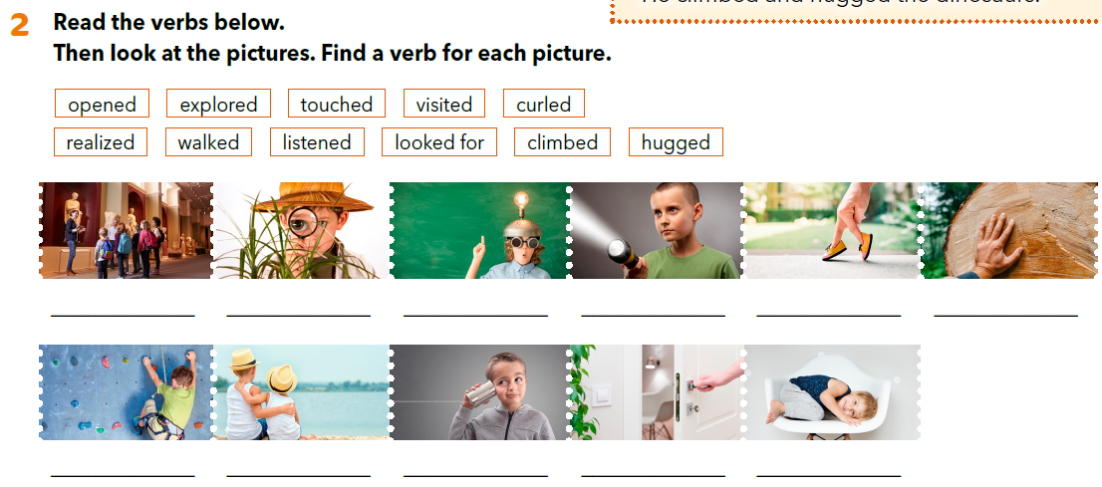
visited
looked for
relized
explored
walked
touched
climbed
hugged
listened
opened
curled

Slide 6

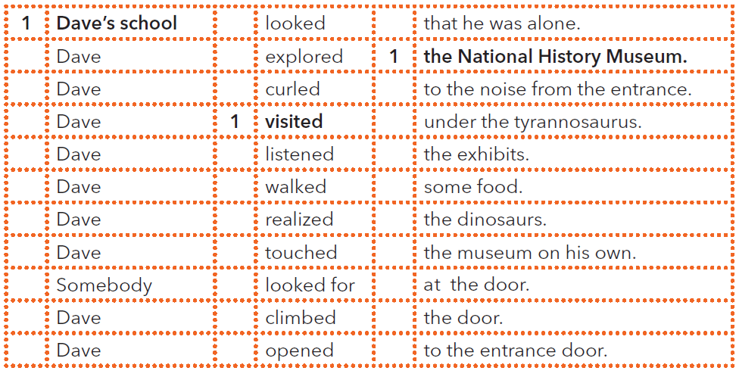
11
3
2
2
3
8
10
4
8
5
10
5
6
4
7
7
3
6
8
5
2
9
7
11
10
6
9
11
9
4

Slide 7
Practise: https://www.bookwidgets.com/play/HK5MT2
https://learningapps.org/watch?v=p0o89jgok20

Slide 8
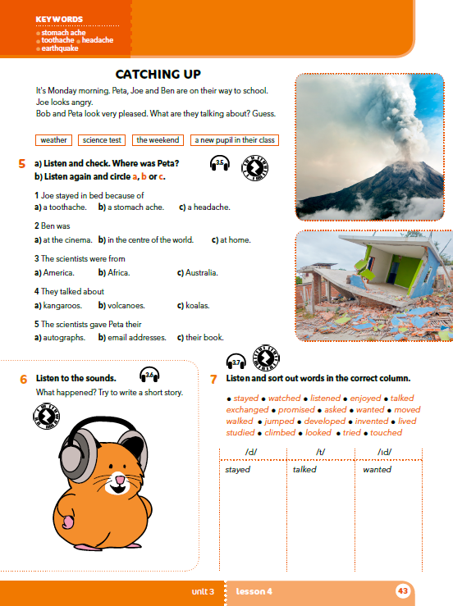
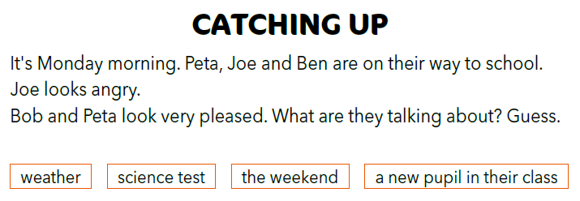

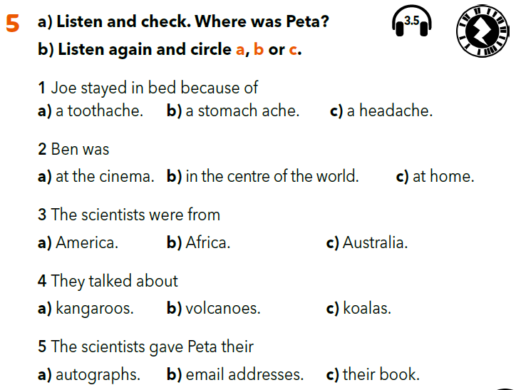
Open your book, page 43.
Listen and check. Where was Peta? Circle a, b or c. https://www.e-sfera.hr/dodatni-digitalni-sadrzaji/1570e502-3238-4234-8542-c9d952e3ca00/assets/audio/14__unit_03_lesson_4_-_catching_up_1.mp3
Peta was at the science festival.

Slide 9
Open your book, page 43.
What was Joe’s weekend like?
What did Ben watch at the cinema?
Where was Peta?
Who did Peta listen to?

Slide 10


You can use these words:
NIGHT, CHILLY, WINDY, RAIN,
STRONGER AND STRONGER,
CRACK, EARTHQUAKE, CURLE.
https://www.e-sfera.hr/dodatni-digitalni-sadrzaji/1570e502-3238-4234-8542-c9d952e3ca00/assets/audio/15__unit_03_lesson_4_-_listen_to_the_sounds_1.mp3

Slide 11
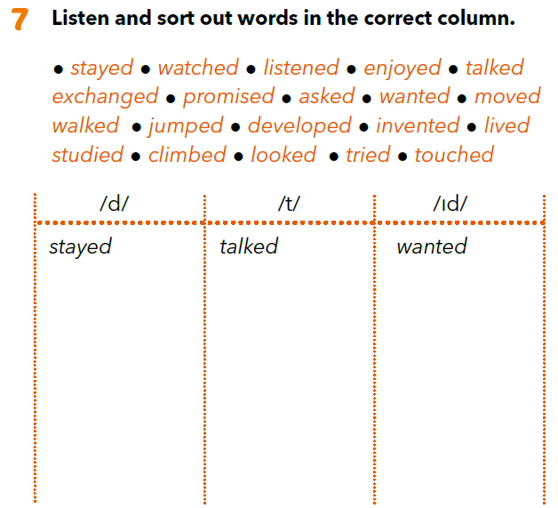
https://www.e-sfera.hr/dodatni-digitalni-sadrzaji/1570e502-3238-4234-8542-c9d952e3ca00/assets/audio/16__unit_03_lesson_4_-_regular_verbs_1.mp3
listened enjoyed exchanged moved
lived
climbed
tried
watched promised
asked
walked
jumped developed looked
touched
invented studied

Slide 12
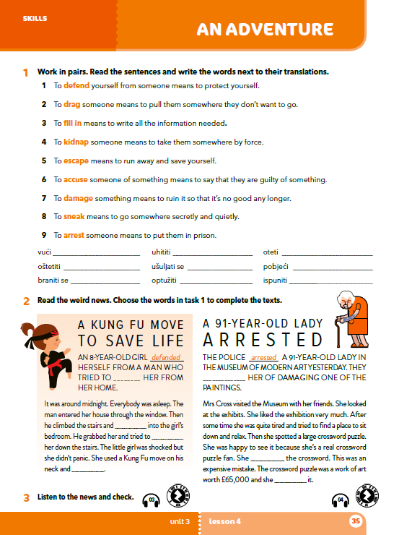
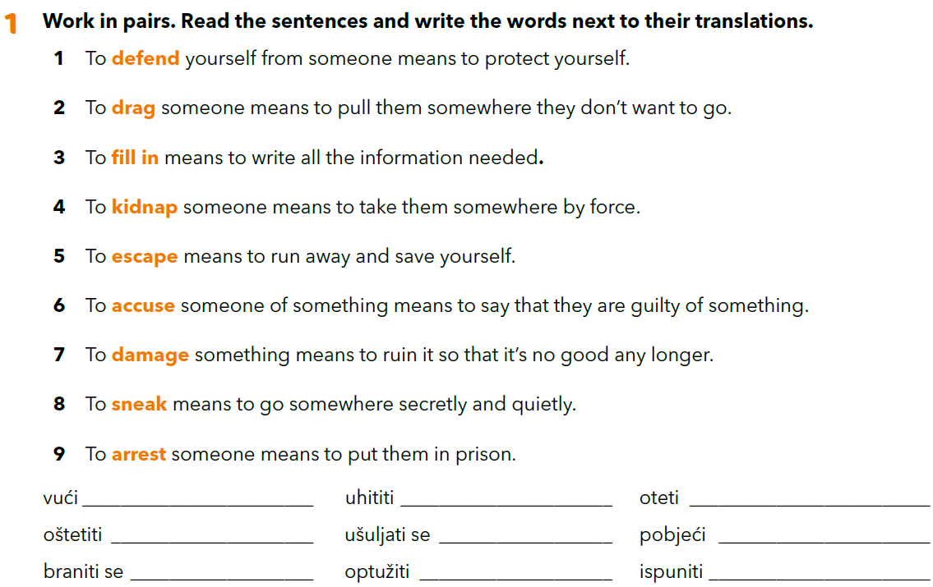
Workbook, p. 35
drag
arrest
kidnap
damage
sneak
escape
defend
accuse
fill in

Slide 13

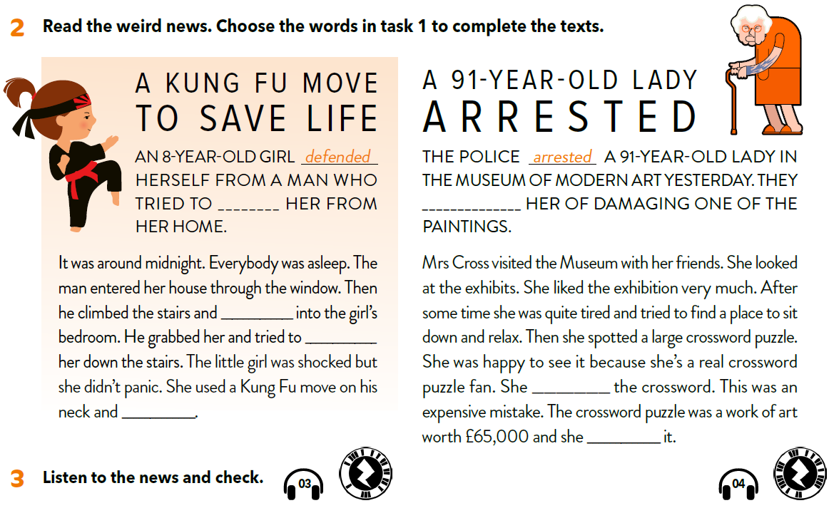
Listen to the news and check. https://www.e-sfera.hr/dodatni-digitalni-sadrzaji/1570e502-3238-4234-8542-c9d952e3ca00/assets/audio/03_wb_t_u3_l4_3_kung_fu_2.mp3
kidnap
accused
sneaked
drag
https://www.e-sfera.hr/dodatni-digitalni-sadrzaji/1570e502-3238-4234-8542-c9d952e3ca00/assets/audio/04_wb_t_u3_l4_4_91-year-old-lady_1.mp3
filled in
escaped
damaged

